Slide 1
GPIO Raspberry pi

Slide 2
GPIO

Slide 3
LED

Slide 4
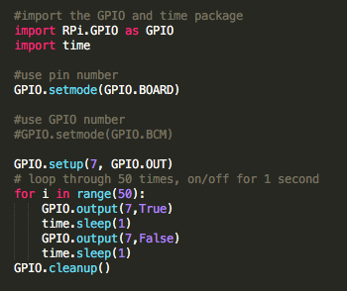
LED

Slide 5
BUTTON

Slide 6
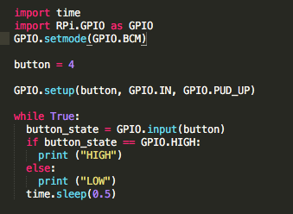
BUTTON

Slide 7
UART

Slide 8
UART
sudo apt-get update
sudo apt-get install python-serial

Slide 9
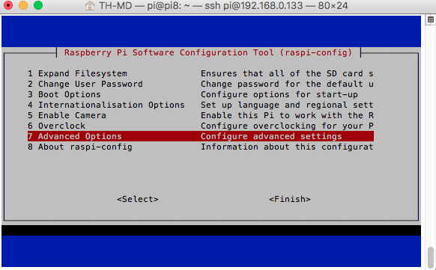
UART
sudo raspi-config

Slide 10
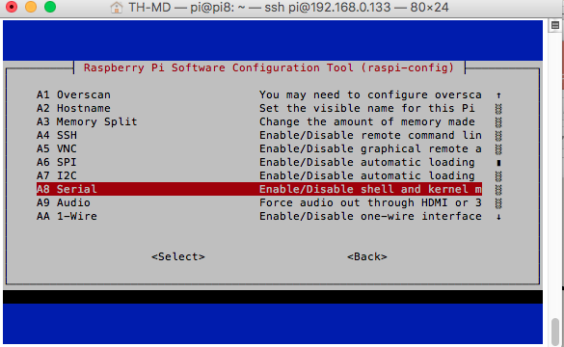
UART

Slide 11
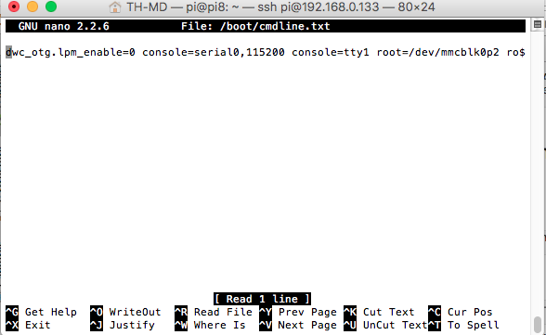
UART
Sudo nano /boot/cmdline.txt (Remove ‘console=serial0,115200’)

Slide 12
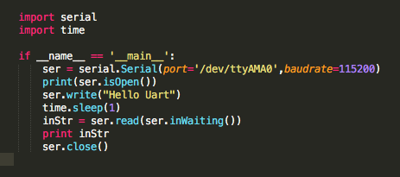
UART

